Slide 1
Interactive Slides for
Middle and High School Students

Slide 2
What is Design?
“Design is the method of putting form and content together. Design, just as art, has multiple definitions; there is no single definition. Design can be art. Design can be aesthetics. Design is so simple, that’s why it is so complicated.” – Paul Rand
What do you think this designer meant when they said this?

Slide 3
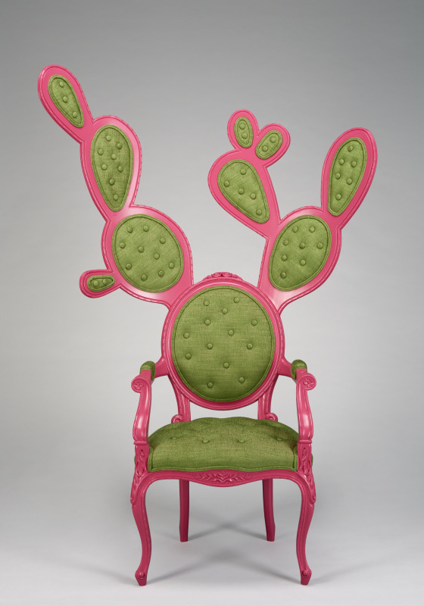
What is Design?
Design is all around us: objects, spaces, images, interactions,
systems, and processes
Design meets a need
Design also is about how it looks (expression of aesthetics – aka beauty)
Design can experiment with forms, techniques, or materials
Copy and paste or draw three images of Design around you right now.
Valentina Gonzalez Wohlers, Prickly Pair Chair, Gentleman Style, 2009. Banak wood, medium-density fiberboard, paint, and upholstery; 71 x 47 x 20 x 20 in. Denver Art Museum, acquired by exchange, 2016.2. © Valentina Gonzalez Wohlers

Slide 4
What is Design Thinking?
Design thinking is a creative problem-solving process.
Not linear
No one correct path
Key phases:
Define: Start with a question or need.
Research: Learn about your problem and users.
Generate ideas: Brainstorm and come up with as many solutions as you can.
Make a prototype: Test your ideas using models and sketches.
Implement: Produce your best idea.
Reflect: Evaluate; seek and incorporate feedback.

Slide 5
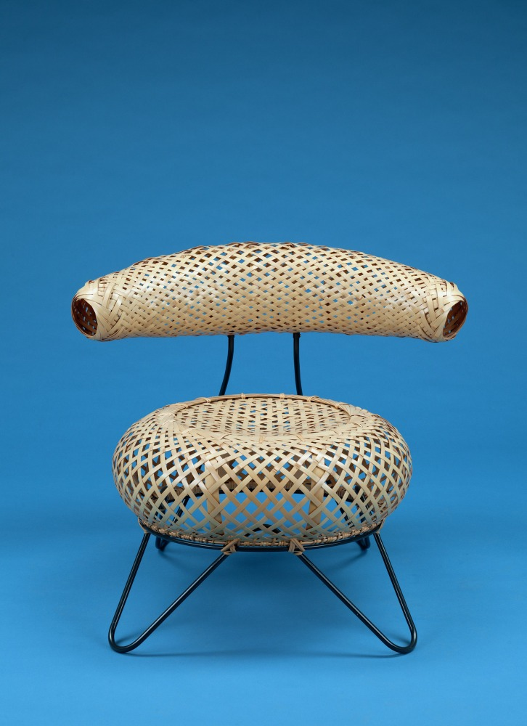
What Makes Design Unique?
Utility and beauty are not mutually exclusive, and when design is at its best you don’t need to choose between aesthetics and functionality.
Designers have a unique ability to instill beauty into their work in order to stimulate our senses and connect to the culture in which it is produced.
Why are chairs the way they are, or what elements make a chair? What do you think influences how they are designed?
Isamu Noguchi and Isamu Kenmochi, Basket Chair, 1950, produced 2008.
Bamboo, wood, and iron; 28 ⅞ x 34 1/2 x 30 in. Lutz Bamboo Collection at the
Denver Art Museum: Gift of Adelle Lutz in honor of Ronald Otsuka, 2010.406.

Slide 6
What makes this Basket Chair unique?
Watch Denver Art Museum Through a Different Lens: Weaver and Engineer Discuss Basket Chair
–featuring the Basket Chair by Isamu Noguchi and Isamu Kenmochi
and consider the form and function of this design.
Notes:
Younger Learners
1.
Design combines beauty and utility
Ideas of beauty influence design and can be informed by history and culture
2. What makes this Basket Chair unique?
Design Note: Imbed video in SLIDES Watch Denver Art Museum Through a Different Lens: Weaver and Engineer Discuss Basket Chair – https://vimeo.com/471162932/7f102ac30b – featuring the Basket Chair by Isamu Noguchi and Isamu Kenmochi. Consider the form and function of this design.
Youngest Learners
Design combines how something looks and how it works
How something looks is affected by history and culture
What makes this Basket Chair special?
Design Note: Imbed video in SLIDES Watch Denver Art Museum Through a Different Lens: Weaver and Engineer Discuss Basket Chair - https://vimeo.com/471162932/7f102ac30b featuring the Basket Chair by Isamu Noguchi and Isamu Kenmochi and consider the form and function of this design.

Slide 7
Conversation Questions for the Video:
What makes the Basket Chair unique?
What connects the Basket Chair to Japanese culture?
What materials is this chair made of? Why might the designers have chosen these materials?
What kind of problem does weaving the bamboo in this chair solve? Or how does weaving the bamboo in this chair solve a problem or need?
What influenced the form (shape) of this chair?

Slide 8
Learn More About This Object
Collaboration between Isamu Noguchi (a Japanese-American sculptor)
and Isamu Kenmochi (a Japanese industrial designer)
Their goals:
Create a universally functional object that builds upon the rich traditions of tatami mats
Combine Western and Japanese modernist aesthetics (look)
Incorporate the beauty of simplicity
Ground the object in appreciation and knowledge of natural materials
Dig Deeper
- Learn more about tatami mats
- Learn more about Isamu Noguchi
–Learn more about Isamu Kenmochi
Isamu Noguchi and Isamu Kenmochi, Basket Chair, 1950, produced 2008.
Bamboo, wood, and iron; 28 ⅞ x 34 1/2 x 30 in. Lutz Bamboo Collection at the
Denver Art Museum: Gift of Adelle Lutz in honor of Ronald Otsuka, 2010.406.

Slide 9
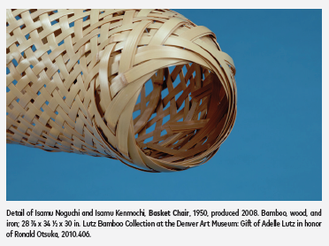
Weaving Innovation
An interesting quality of Basket Chair is that it is woven with bamboo strips. Weaving is a centuries-old art form with a rich and extensive history that continues to evolve. From a necessary household chore to a skill-driven occupation to a form of personal expression, weaving has been re-envisioned and transformed by generations of dedicated makers. Weaving is a practice that transcends cultural boundaries. Examples of different techniques and uses from cultures around the globe emphasize how the craft reflects cultural traditions. Today, contemporary artists, designers, and craftspeople are producing exciting new work drawn from the lessons of those who came before. The materials used and their varied applications make for incredibly surprising objects in an array of forms. Compare this bamboo Basket Chair to these other woven artworks (historic and contemporary) in the Denver Art Museum collection.
Where do you notice weaving in your world?
Dig Deeper
Japanese Weaving Traditions
Bamboo: Tradition in Contemporary Form

Slide 10
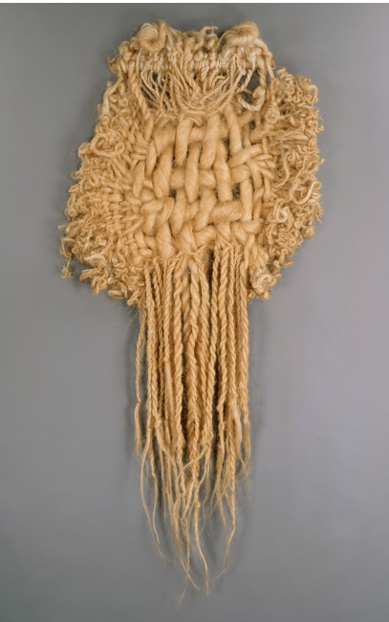
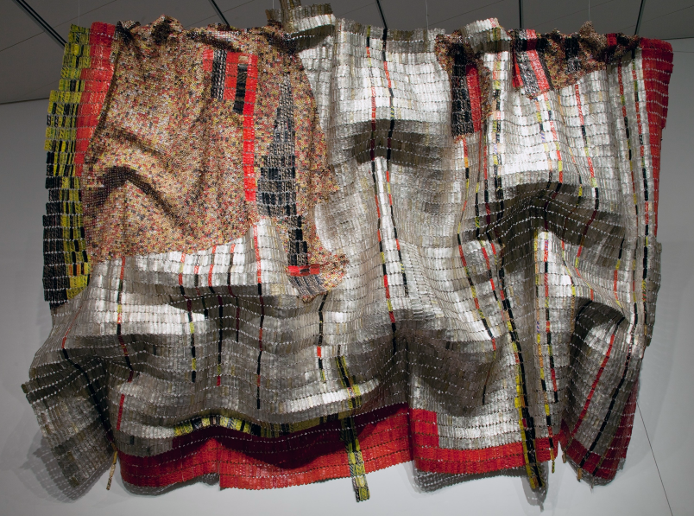
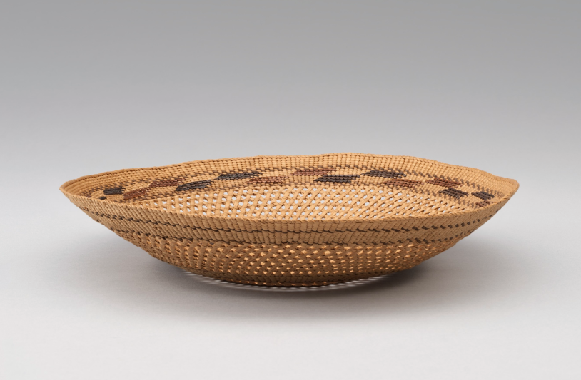
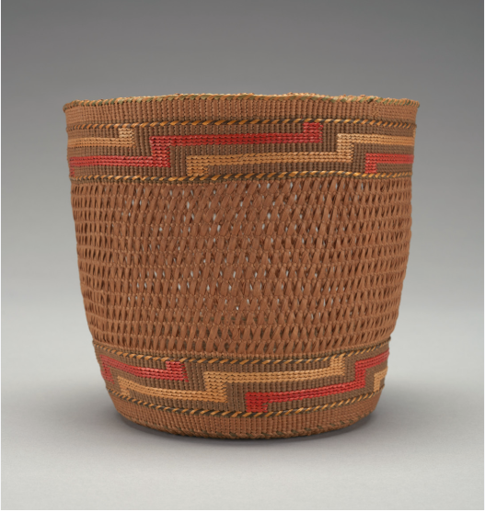
Weaving Innovation
Click on each image to learn more:
Conversation Questions
What materials can you spot?
How did each of these artists apply weaving techniques differently?
What is surprising about these weavings to you?
Image credits found in the e notes.
Notes:
1. El Anatsui (Ewe), Rain Has No Father?, 2008. Found bottle tops and copper wire; 153 x 239 in. Denver Art Museum: Funds from Native Arts acquisition fund,U.S. Bank, Richard and Theresa Davis, Douglas Society, Denver Art Museum Volunteer Endowment, Alex Cranberg and Susan Morris, Geta and Janice Asfaw, Saron and Daniel Yohannes, Lee McIntire, Milroy and Sheryl Alexander, Dorothy and Richard Campbell, Wayne Carey and Olivia Thompson, Morris Clark,
Rebecca H. Cordes, Kenneth and Rebecca Gart, Tim and Bobbi Hamill, Kalleen and Robert Malone, Meyer and Geri Saltzman, Ann and Gerry Saul, Mary Ellen and Thomas Williams, Nancy and James Williams, Forrest Cason, First Western Trust Bank, Howard and Sandy Gelt, Gene Osborne, Boettcher Foundation,John and Eve Glesne, The Schlegel White Foundation, Jeffrey and Nancy Balter, and Tamara Banks, 2008.891. c El Anatsui
2. Tadek Beutlich, Moon Worshipper, 1971. Sisal weaving; 82 x 44 in. Neusteter Textile at
the Denver Art Museum Collection: Gift of Mr. and Mrs. Edward M. Strauss, 1983.236. c Tadek Beutlich
3. Tlingit artist, Basket, c. 1911. Fiber and dye; 6 . x 7 . x 6 . in. Denver Art Museum:
Gift of Nancy L. Harris and Hamilton R. Harris, 2018.740.
4. Tlingit artist, Basket, about 1900. Spruce root; 1⅝ x 7. in. Denver Art Museum: Gift of Pat Carney and Charlie Anderson, 2015.15.

Slide 11
Copy and paste two chairs from the Denver
Art Museum that you find most interesting.
Activity Extension
The Basket Chair is just one chair in a long history of chairs, and of designers exploring the design process, making it a perfect place to start. Learn about design thinking by looking at two aspects of the process – define and iterate – using the evolution of the office chair as an example.
Throughout history, chairs have symbolized the life and times of designers and consumers. Like any work of art, a chair’s construction, materials, maker, and style can tell volumes about the culture from which it emerged. Materials and methods of production multiplied by imagination yields a nearly unlimited number of solutions to the problem of where to sit. What was important at the time? Who were they made for? What spaces did they inhabit? As art and design evolve over time, chair design does too. However, the primary purpose has not changed – for millennia, people have needed a place to sit. As such, the chair is a perfect marker for the ever-changing history of design.
Check out just a few of the chairs in the Denver Art Museum collection!
What interests you about these chairs?

Slide 12
Define the Problem
What might we be able to learn about the needs of the users of these chairs?
What does the chair reveal about the time or culture in which it was made?
What do the characteristics of the chair reveal about the needs of its users?
Copy and Paste two chairs from the Denver Art Museum that you find most interesting.

Slide 13
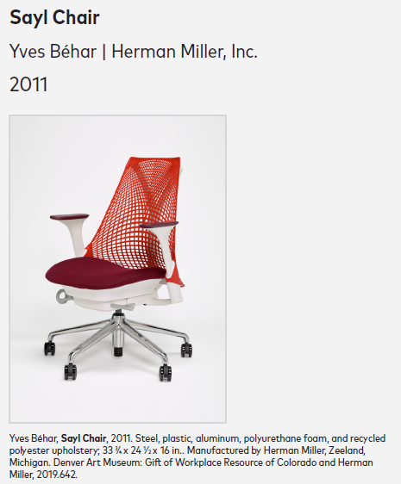
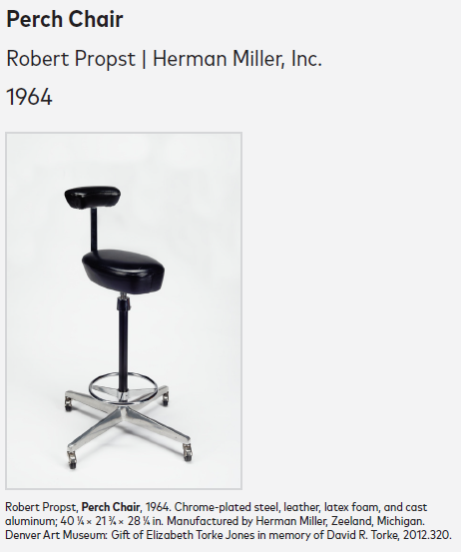
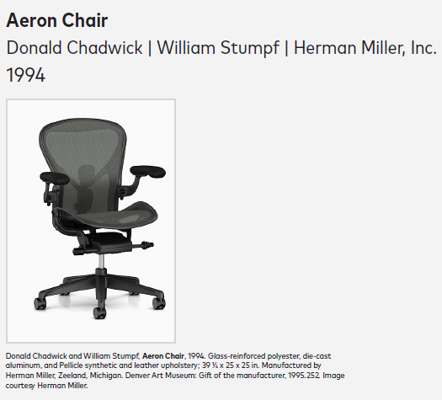
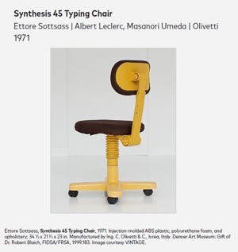
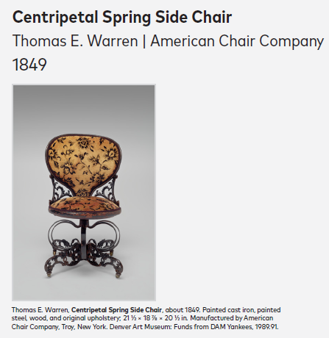
Iteration (i.e., the cycle of prototyping, testing, and making adjustments)
Rearrange these task chairs chronologically, based on the date found on the label.
What are some of the changes you notice over time? And why do you think that is?
Which elements of these chairs have remained the same? And why do you think that is?
Notes:
Different chairs?

Slide 14
Activity Extension
Draw, build, or imagine a design for the office chair of the future.
What do you think work look like in the future?
What are the needs of the future office worker?
How does your chair design meet these needs?
Share a photo or video or sketch of your redesigned office chair

Slide 15
Your Turn:
After learning how designers blur the boundaries between beauty and utility, are inspired by culture, and experiment with form and materials with these chairs, it is your turn to think like a designer and redesign the world around you. We will intentionally start designing with our own ideas of beauty, in order to investigate the role of aesthetics in the design process.
1. Make a list of interesting objects that are useful/purposeful in your life. (e.g., headphones, a teapot, sneakers, etc.)
2. Choose one object to redesign with your own requirements for beauty/intrigue in mind. Consider how cultural elements that are important to you could play a role in how your object looks. Think about how your material choices impact your design, just like the use of bamboo in the basket chair.
3. Make a prototype of your idea: create a drawing or 3D model (life-size or miniature).
4. Share your redesign with others and collect their feedback. How do they feel about how it looks? How do they feel about how it works?
5. Next redesign for another user. Use this virtual spinner to select an end user for your object.
6. Empathize with your end user. What do you think their needs might be? And why? Look up any information about your end user that you can.
7. Iterate your design by making another version of your drawing or prototype.
8. Share your newest iteration with others and collect their feedback.
9. Continue reflecting and iterating as many times as you would like.
DAM DIY: Artist Solve Problems
Draw inspiration from Ivan Lazcano-Limon's design of a classic hair pin and watch as they reimagine their design for T'Challa, from the Black Panther movie.

Slide 16
Voice Record or Write answers to these Reflection Questions:
What was it like for you to make multiple iterations of your design and receive feedback? How did feedback affect the end result?
In what ways did you combine utility and aesthetics in any of your iterations?
How was your design affected by culture?
In this challenge you designed for beauty and intrigue first. What effect did that have on your work? Were there any drawbacks to this approach?
What else might you want to redesign in your world?
Share a photo or video or sketch of your first design
Share a photo or video or sketch of your second design

