Slide 1
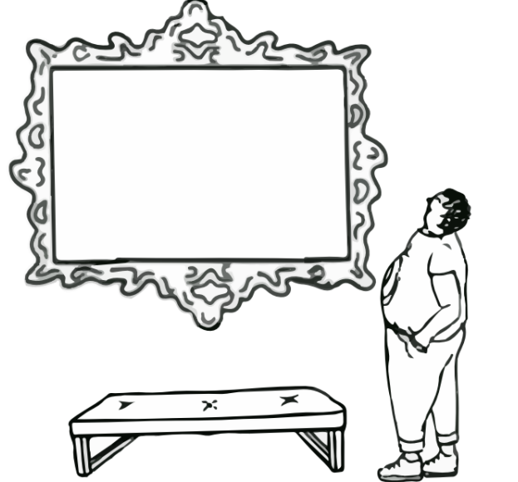
Interactive Slides
for
Elementary School
Students

Slide 2
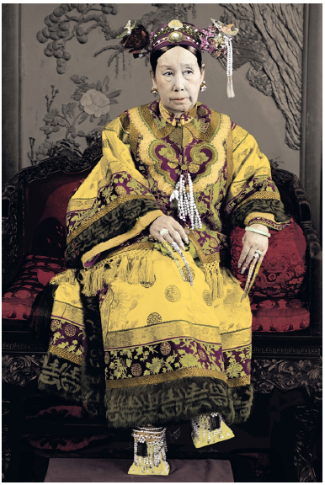
Gender Relations Are Power Relations
Other identities that effect power:
race
color
class
sexuality
ability
religion
belief
Draw a woman who you think holds power
Examining the history of Cixi, we can dispel misconceptions that women in Qing Dynasty China were passive figures.
Ideas of gender and gender stereotypes are just two parts of a very
complex system of power and privilege.
These might look different in different cultures and different
time periods.
China: Official portrait of Empr... Yu Xunling
(c.1880–1943) Credit: Pictures from History/Bridgeman Images.

Slide 3
Watch Denver Art Museum Through a Different Lens:
Historian and Political Strategist Discuss
Empress Cixi
Conversation Questions:
In what ways did Empress Cixi emphasize her power using fashion or accessories?
How do some female-identifying politicians communicate/express their self-image today?

Slide 4
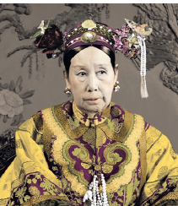
About Empress Dowager Cixi
There have been several very powerful empresses in China’s history, and Cixi was able to take power (with the support of many of the men at court) because there was already a system for women as de facto rulers China. This was called ”ruling from behind the curtain.” Cixi followed in the footsteps of powerful empresses throughout history.
Empress Dowager Cixi was the de facto ruler of China for decades. Cixi did not seize power alone, but along with the former emperor’s principal wife and his two brothers. She did this with the support of men as well as other powerful women.
Think of a powerful figure and
write their name here:
Who do you think supported them?
Who do you think supported them?
Who do you think supported them?
China: Official portrait of Empr... Yu Xunling
(c.1880–1943) Credit: Pictures from History/Bridgeman Images.

Slide 5
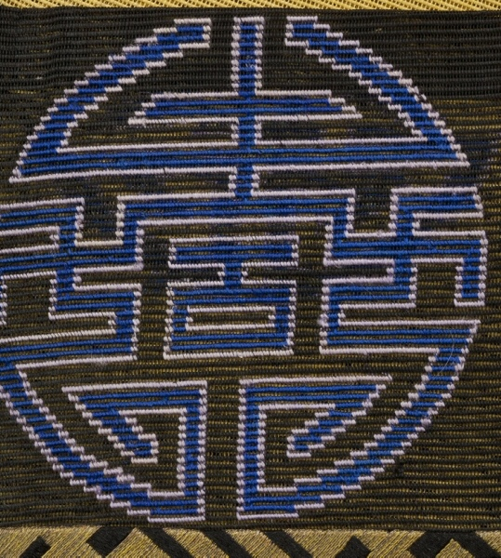
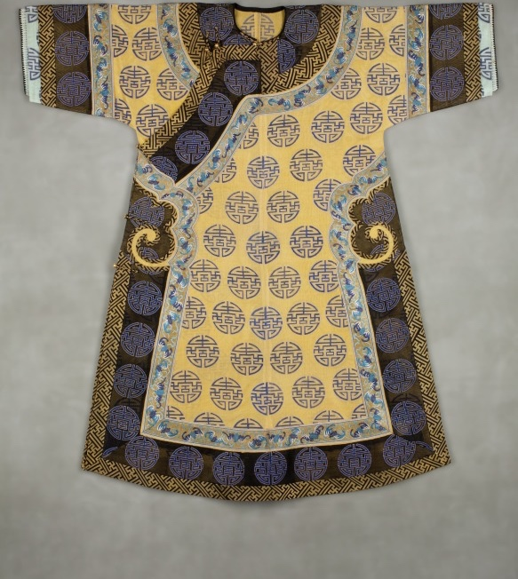
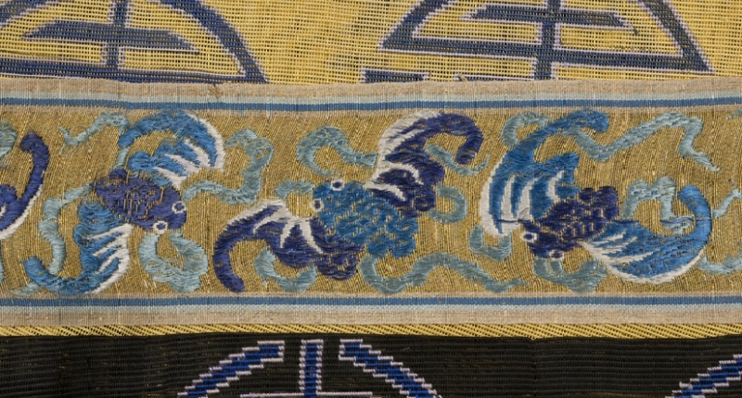
Manchu Woman’s Informal Robe, China, early 1900s. Silk and metal thread embroidery on silk gauze. Neusteter Textile Collection: Gift of James P. Grant and Betty Grant Austin, 1977.214.
About Empress Dowager Cixi
Cixi wore bright yellow robes. Bright yellow like this could only be worn by those of the highest rank. Yellow in Manchurian culture is reserved only for the imperial families. Commoners are not allowed to use this color.
What did Cixi’s fashion choices communicate?
What kinds of items might you wear to express a high status/rank in our current society?
Who decided the rules about showing status in fashion?

Slide 6
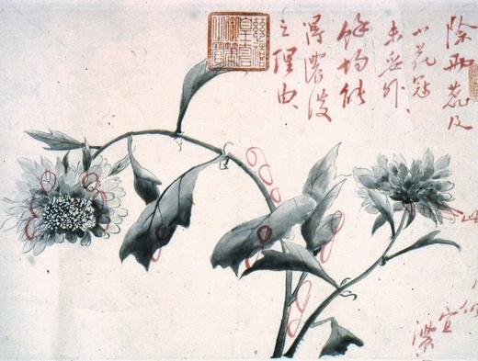
Cixi’s practice of painting and calligraphy works reveals her effort to participate in the gentlemen’s arts. This painting is painted with ink, which is traditionally associated with literati (male scholar) culture, and represents purity, [and] nobility. (Peng, p. 180)
Why do you think these the idea of this kind of painting was originally associated with men?
How can we empower one another to try things no matter what gender they identify with?
Empress Dowager Cixi (Chinese, 1835-1908), Flower and Insect Sketches, 19th century, Qing Dynasty (1644-1911). Ink and color on paper. Denver Art Museum; Gift of Dr. Robert Rinden, 1971.42.
Peng, Y. (2014). Staging Sovereignty: Empress Dowager Cixi (1835–1908) and Late Qing Court Art Production. UCLA. ProQuest ID: Peng_ucla_0031D_12793. Merritt ID: ark:/13030/m52n7938. Retrieved from https://escholarship.org/uc/item/7m334241
Notes:
Peng, Y. (2014). Staging Sovereignty: Empress Dowager Cixi (1835–1908) and Late Qing Court Art Production. UCLA. ProQuest ID: Peng_ucla_0031D_12793. Merritt ID: ark:/13030/m52n7938. Retrieved from https://escholarship.org/uc/item/7m334241

Slide 7
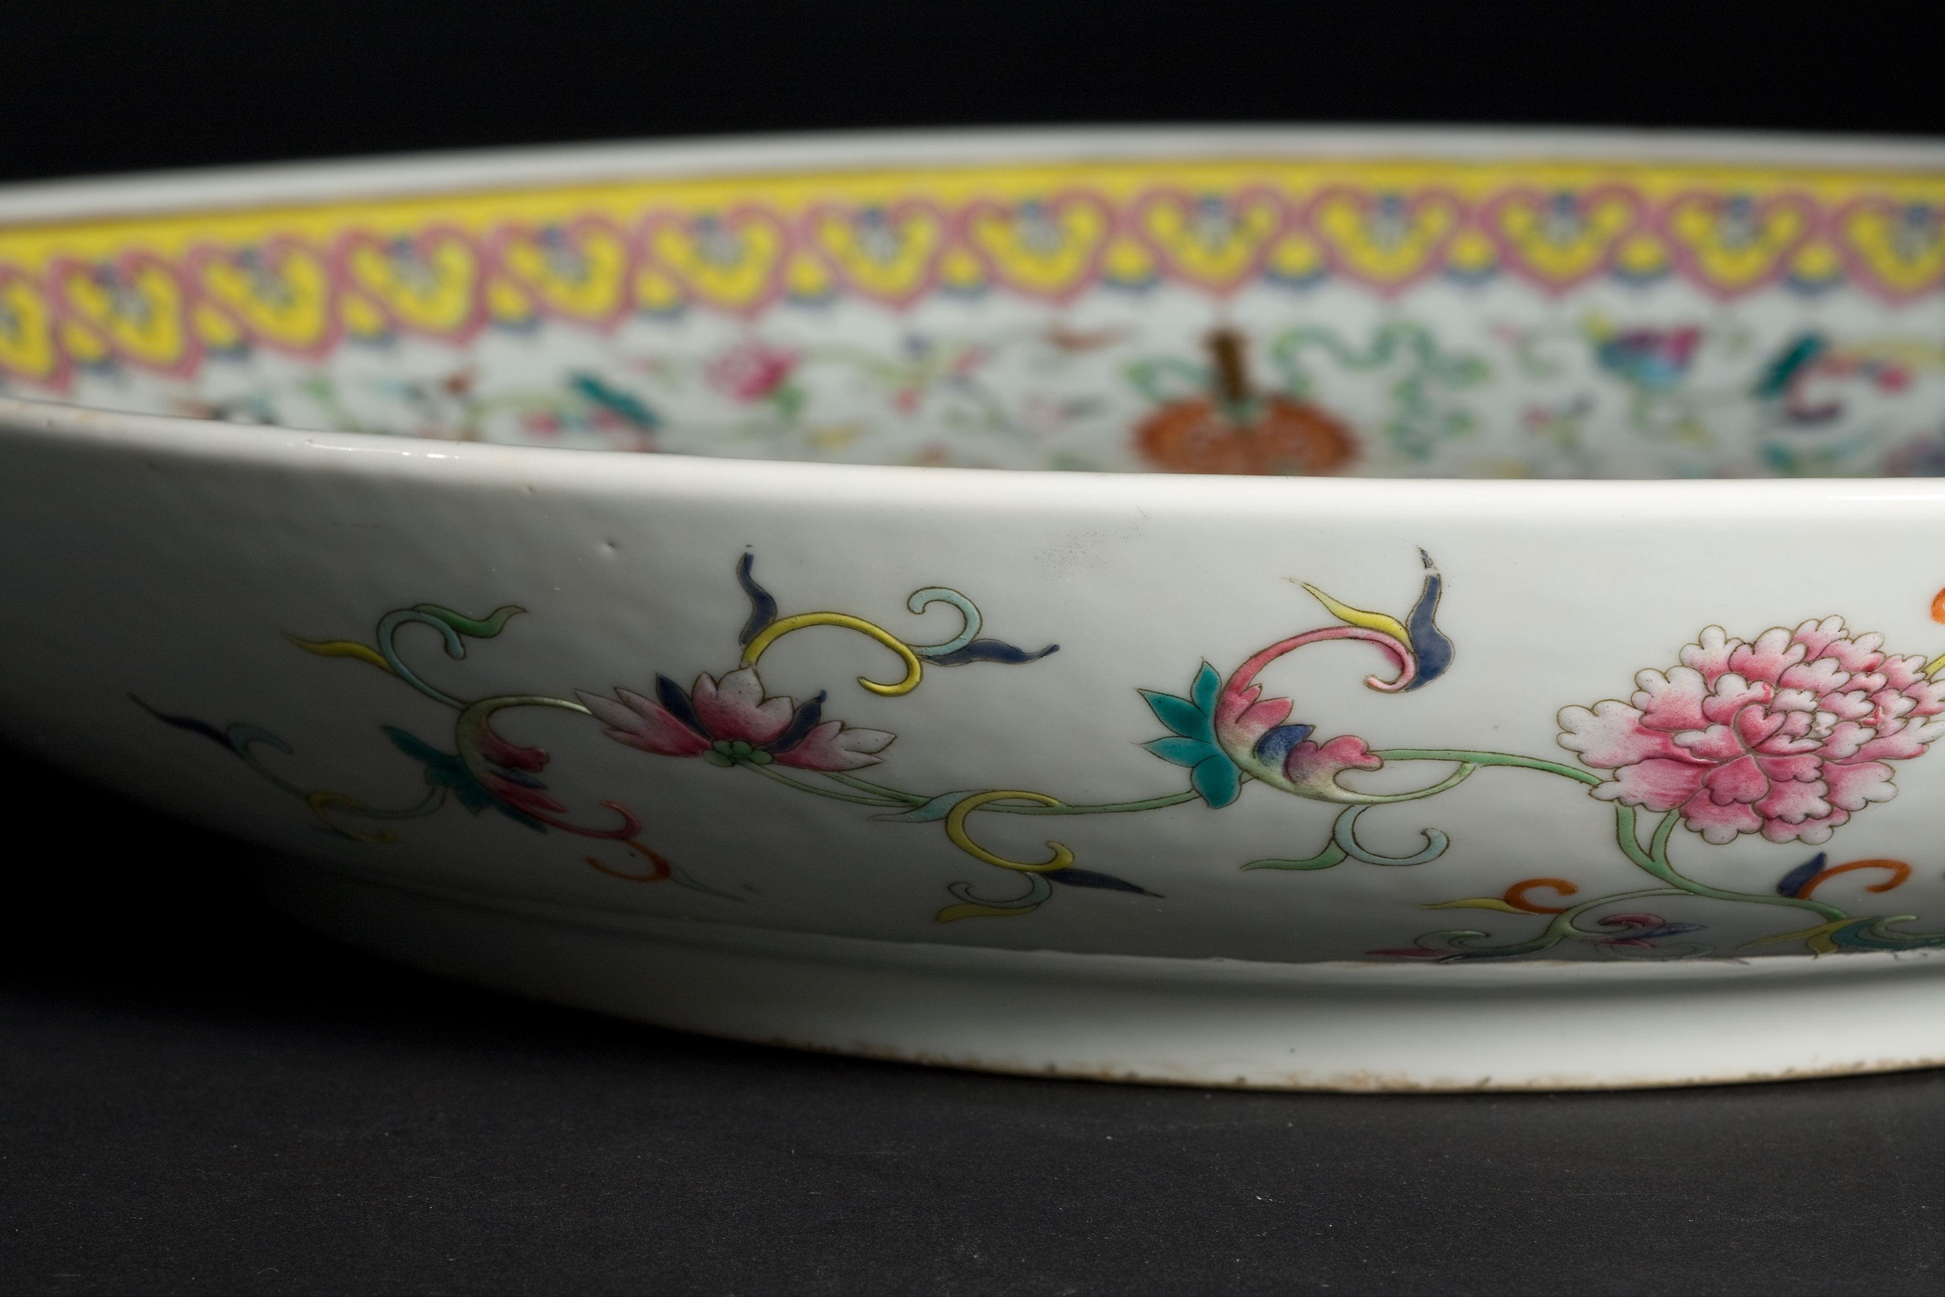
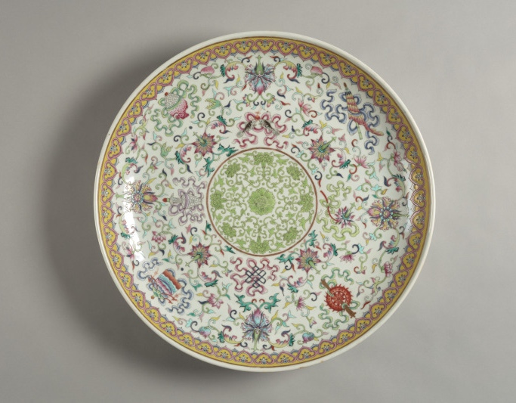
Those in powerful positions, such as emperors, often commissioned, or requested, special ceramic pieces, paintings, or calligraphies. During her time as ruler, Empress Dowager Cixi had porcelain commissioned for her, a request that was uncommon for women in this period.
Detail, Dish, late 19th century, Qing Dynasty (1644-1911), China. Porcelain. Denver Art Museum: Gift of May Wilfley in memory of her parents, A.R> Wilfley and Addie M. Wilfley, 1974.53.
In order to express political power, what kind of object might make sense to produce today?
Dish, late 19th century, Qing Dynasty (1644-1911), China. Porcelain. Denver Art Museum: Gift of May Wilfley in memory of her parents, A.R> Wilfley and Addie M. Wilfley, 1974.53.

Slide 8
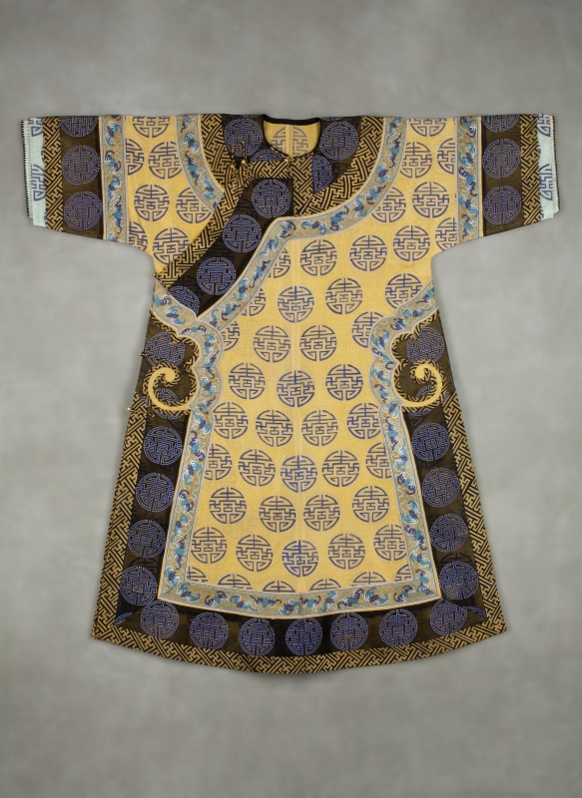
Clothes Are for Everyone
Empress Dowager Cixi used the way she dressed and how her image was shared to gain power.
In 18th- and 19th-century China, this bright yellow color was reserved only for those in the highest level of royalty.
Fashion can be a way to define one’s cultural and gender identity or to resist authority. Fashion includes textiles, accessories, colors, etc.
Notes:
Youngest Learners
Clothes Are for Everyone
Empress Dowager Cixi used the way she dressed and how her image was shared to gain power.
In 18th- and 19th-century China, this bright yellow color was reserved only for those in the highest level of royalty.
Cixi wore clothes and accessories that expressed what she wanted others to know about her.

Slide 9
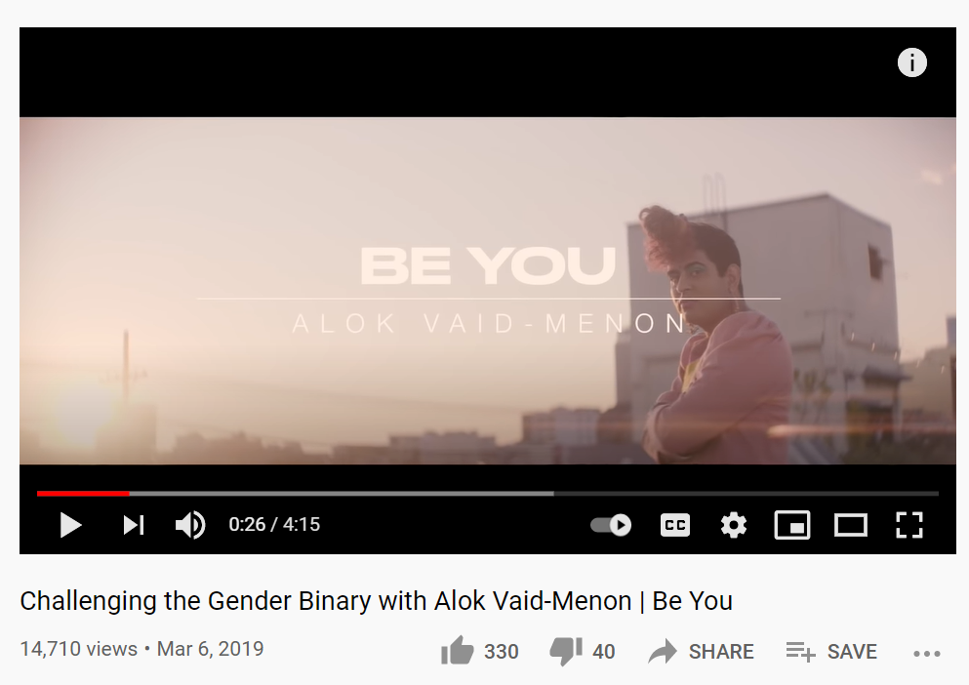
Fashion can be a way to define one’s cultural and gender identity or to resist authority. Fashion includes textiles, accessories, colors, etc.
Fashion is a way to express ourselves in a variety of ways.
Building on the idea that clothes have been traditionally tied to gender expectations, Alok Vaid-Menon, a gender-nonconforming activist, speaks about fashion and clothes being for anyone and for all people to be able to self-determine their gender.
“I believe fashion should be a celebration of beauty. I believe that the gender binary
is an obstacle to beauty. It limits our self-expression and confines our … imagination.”
– Alok Vaid-Menon
What does that quote mean to you?

Slide 10
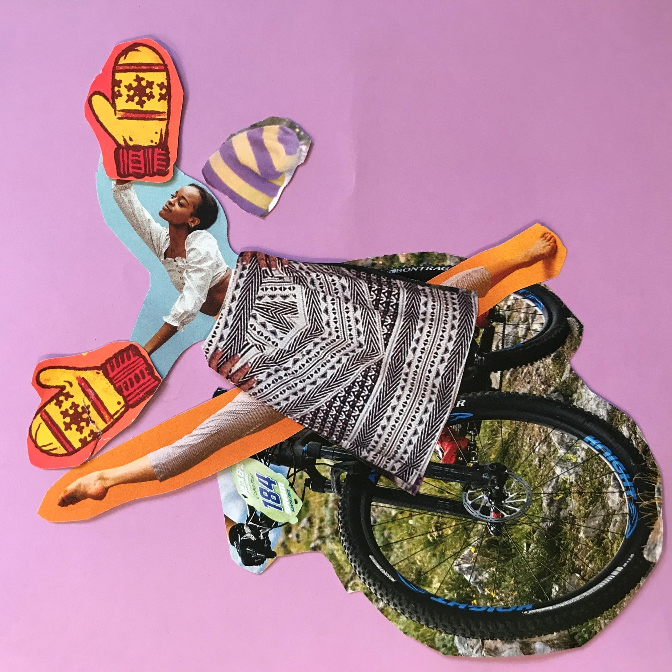
Your Turn:
What would you wear to celebrate your own inner beauty and express what makes you
strong? Play dress-up using collage.
1. Choose pictures of items from magazines or newspapers to create the most celebratory outfit you can think of!
2. Arrange and glue your self-celebratory outfit on a blank paper or cardboard.
Share the significance of items in your outfit.
Reflection Questions:
How did it feel to express your inner beauty and strength?
In what ways did creating an outfit that celebrated your inner beauty feel the same or different from when you get dressed each day?
Share a photo of your collage Here:

Slide 11
Youngest Learners
Cixi did many things others didn’t expect in order to be true to her inner self.
Read the book Red: A Crayon’s Story by Michael Hall. This book is about being true to your inner self and following your own path despite obstacles that you may encounter, kind of like Empress Dowager Cixi.
Reflection Questions:
How do you think the red crayon felt when it couldn’t color in red?
How do you think it felt when it could finally color in blue?
How might we help people feel like it is okay to feel or be different?
How might the red crayon and Empress Cixi’s stories be similar? How might they be different?
Find it at the library
Or listen to this read aloud:

